Slide 1



Who break your heart?
Symptomatic factors on Heart Disease
Zhai Yibo, Shen Hanpu, Luo Yiling
2020-12-25

Slide 2
Context
Problem Overview
Solution Process
Model Selection
Key Findings
Fraud Detection
Summary

Slide 3

PART I
Problem Overview

Slide 4
Background
The term "heart disease" is often used interchangeably with the term "cardiovascular disease." Cardiovascular disease generally refers to conditions that involve narrowed or blocked blood vessels that can lead to a heart attack, chest pain (angina) or stroke.
There are some types of heart disease such as:
Arrhythmia(心律失常）. An arrhythmia is a heart rhythm abnormality.
Atherosclerosis（动脉粥样硬化）. Atherosclerosis is a hardening of the arteries.
Cardiomyopathy（心肌病）. ...
Congenital heart defects（先天性心脏缺陷）. ...
Coronary artery disease (冠状动脉疾病). ...
Heart infections（心脏感染）.

Slide 5

Background
HOWEVER!
The cumulative death of COVID-19 is 1,725,959
But every year people die of heart disease are 17,300,000, taken 30% of the total death number.
In China, 3 people die of heart disease every single minute.
And most of the undergraduate die of heart arrest(心脏骤停）.
So it makes sense for us to pick this data, during our process we hope to give you some idea of the factors that are associated with heart disease and how to prevent it.

Slide 6

PART II
Solution Process

Slide 7
Analyze Data
(Abbreviation: “int”: integer, “cat”: categorical, “con”: continuous, “dep”: dependent)
Predictors | Explanation
Age | The person’s age in years | int
Sex | The person’s sex | cat
Chest-pain type | The chest pain experienced (0-3) | int
Resting Blood Pressure | Displays the resting blood pressure value of an individual in mmHg (unit) | con
Serum Cholesterol | displays the serum cholesterol in mg/dl (unit) | con
Fasting Blood Sugar | compares the fasting blood sugar value of an individual with 120mg/dl. | cat
Resting ECG | displays resting electrocardiographic results | Int
Max heart rate achieved | The person’s maximum heart rate achieved | con
Exercise induced angina | 1 = yes 0 = no | cat
Old-peak | ST depression induced by exercise relative to rest | con
Peak exercise ST segment | the slope of the peak exercise ST segment | cat
Number of major vessels | The number of major vessel colored by flourosopy (X线透视检查) (0-3) | int
Thallium Test | displays the Thallium Test | cat
Diagnosis of heart disease | 0 = no disease 1 = disease | dep
Retrieved data from https://www.kaggle.com/ronitf/heart-disease-uci

Slide 8
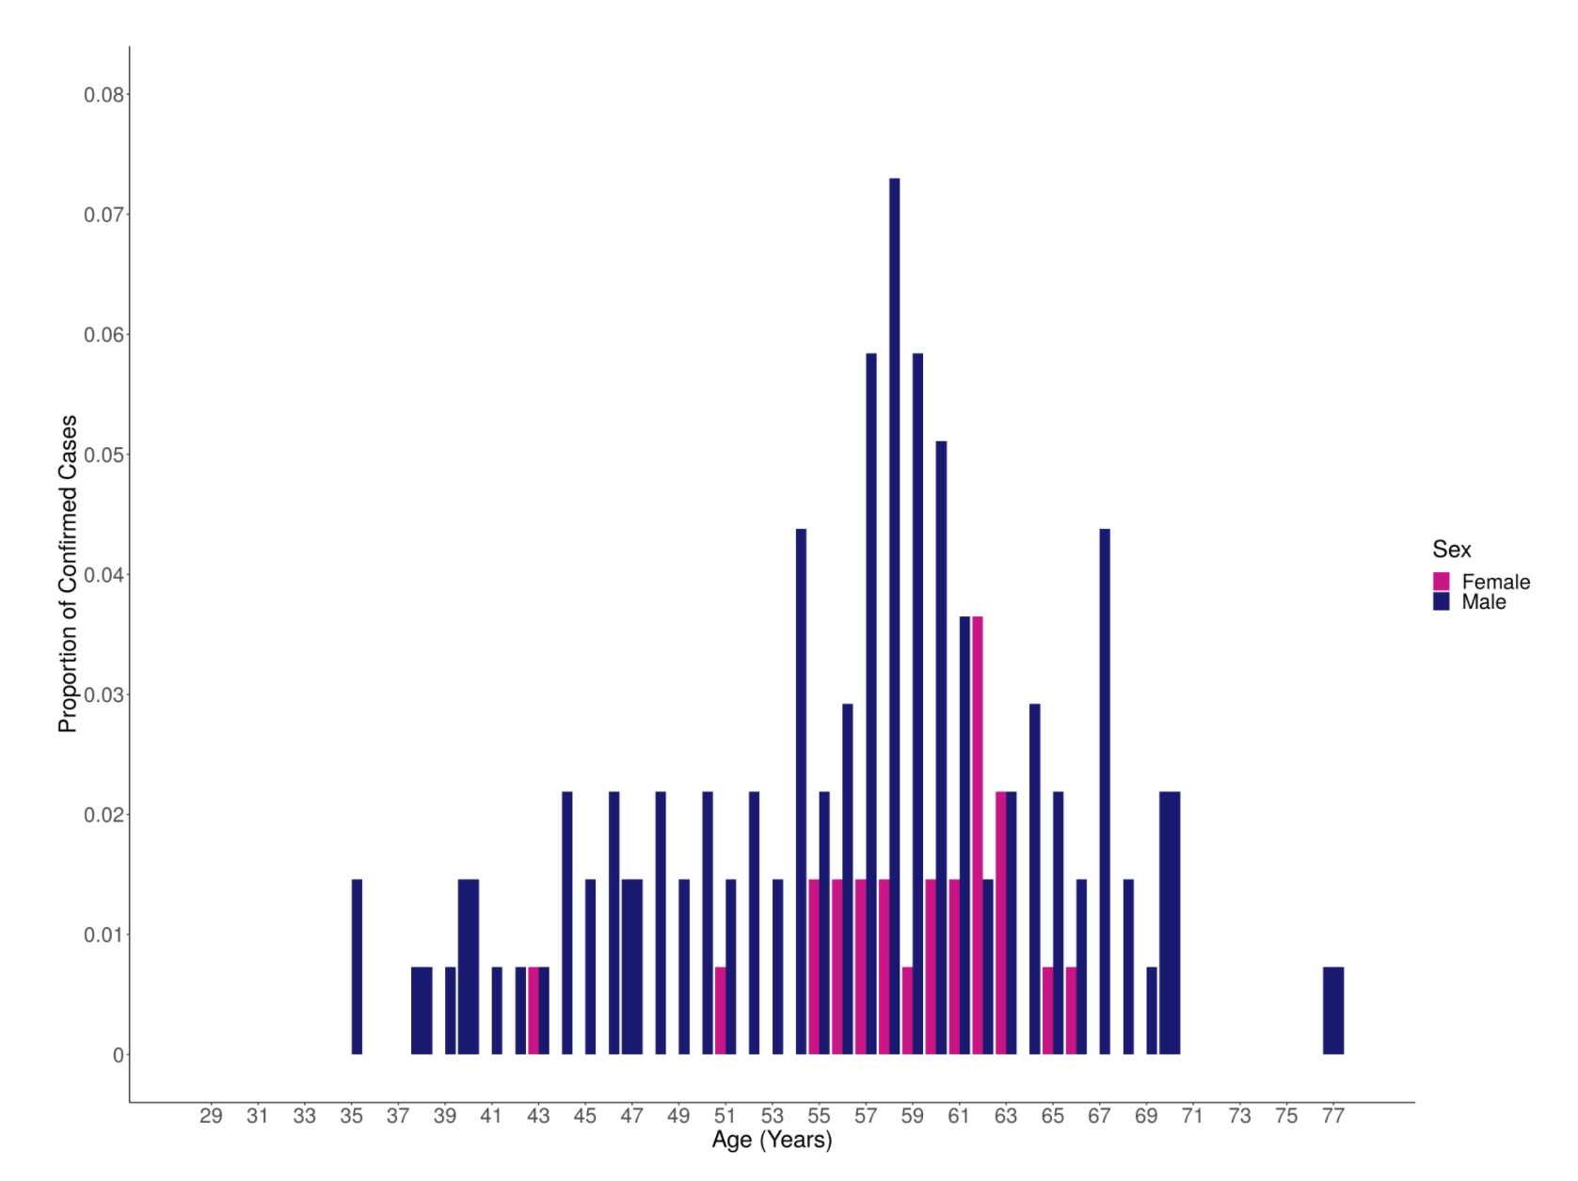
Descriptive statistic

Slide 9
Analytical approach
Logistic
KNN
ANN
LDA
Random Forest

Slide 10
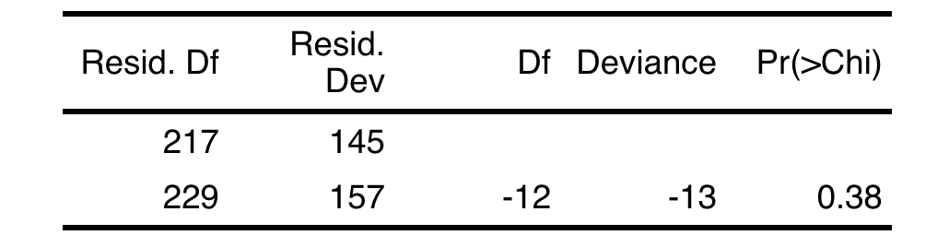
Logistic Regression
Advantage:
1. Logistic regression is less prone to over-fitting
2. Logistic Regression can make a clear inference
3. Logistic regression is easier to implement, interpret and very efficient to train.
Assumptions:
Binary form
Lack of multicollinearity
Lack of influential points
linear relationship between the logit of the outcome and each predictor variables
Variable selection:
we used Stepwise method under BIC criteria to find the reduced model.

Slide 11
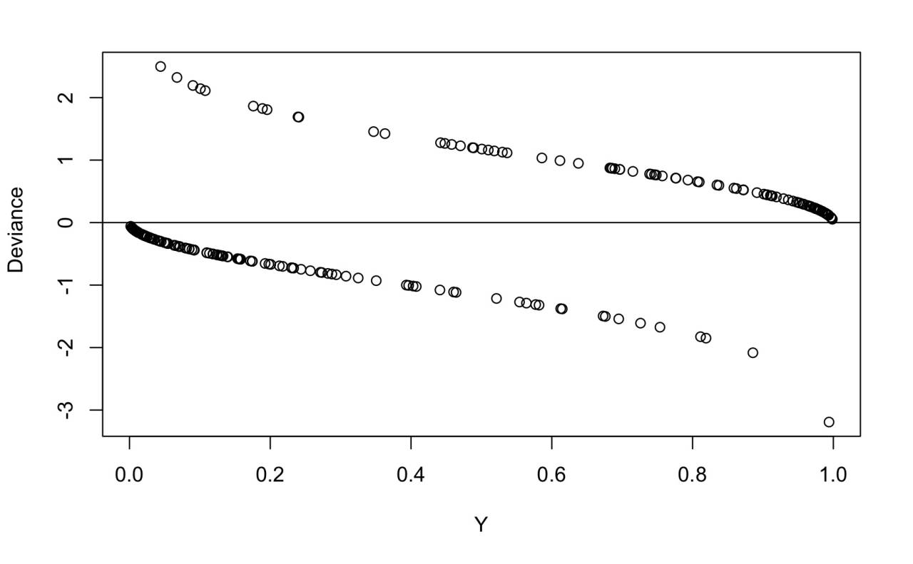
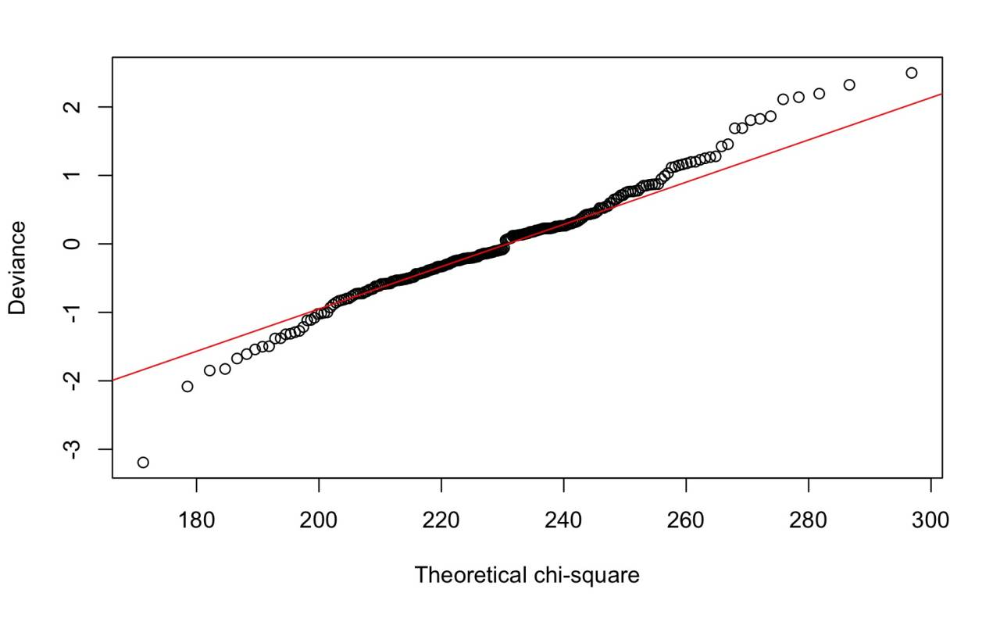
Logistic Regression
Diagnosis
1) Residual Analysis:
In generalized linear model, the deviance should follow chi-square distribution, if n is large enough. As shown in Figure 9 and 10, the residuals roughly follow chi-square distribution, which indicates that the model captures all the features in the data.

Slide 12
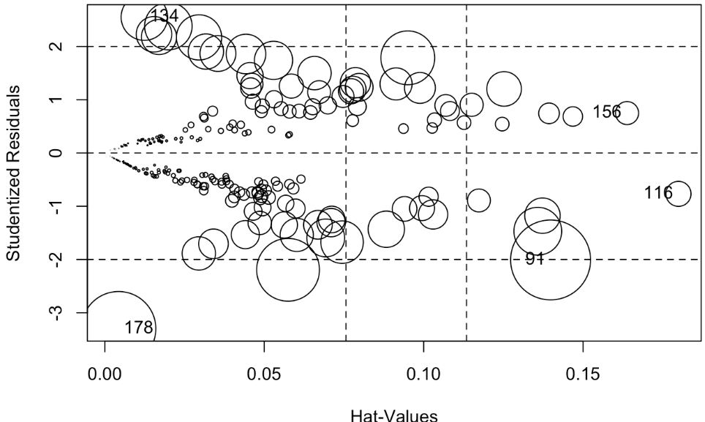
Logistic Regression
2) Multicollinearity:
We didn’t find any multicollinearity from the VIF table.
Factor | VIF
Sex | 1.32
Trestbps | 1.18
Thalach | 1.14
Cp3 | 1.17
Ca1 | 1.15
Ca2 | 1.14
Ca3 | 1.04
Thal2 | 1.12
3) Influential points:
From the influential plot, we detect the following points
as influential p .
Figure 1: VIF table
Patients | StudRes | Hat | CookD
91 | -2.01 | 0.14 | 0.09
116 | -0.77 | 0.18 | 0.01
134 | 2.55 | 0.012 | 0.03
156 | 0.75 | 0.16 | 0.01
178 | -3.30 | 0.004 | 0.08
Figure 2: Influence plot
Figure 3: VIF table

Slide 13
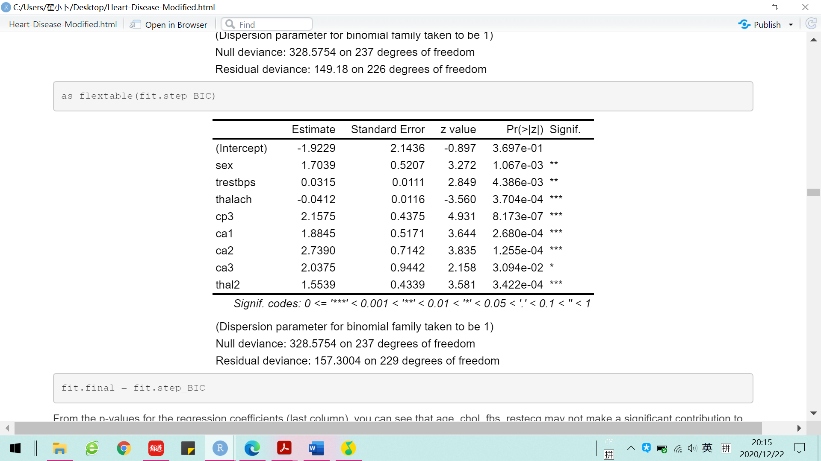
Logistic Regression
4. Final Model
Figure 1: Final model
Table 1: exp(Coefficient)
Factors | Coefficient
Intercept | 0.146
sex | 5.495
trestbps | 1.032
thalach | 0.959
cp3 | 8.649
ca1 | 6.583
ca2 | 15.471
ca3 | 7.671

Slide 14
Linear Discriminant Analysis (LDA)
Linear Discriminant Analysis (LDA) :
like Principal Component Analysis (PCA), a method of dimensionality reduction. However, both are quite different in the approaches they use to reduce dimensionality. LDA chooses new axes such that the separability between two classes is optimized, and hence is a supervised technique.^{[1]}
Advantage:
1. For situations where we have small samples and many variables, LDA is largely preferred.
2. No distribution assumption.

Slide 15
KNN
KNN:
is a non-parametric method used for classification and regression. In k-NN classification, the output is a class membership. An object is classified by a plurality vote of its neighbors, with the object being assigned to the class most common among its k nearest neighbors, If k = 1, then the object is simply assigned to the class of that single nearest neighbor.
Advantage:
Easy to understand, high precision and mature theory, can be used for both classification and regression.
It is suitable for the class domain with large sample size.

Slide 16
KNN
Parameter Selection:
K = 9

Slide 17
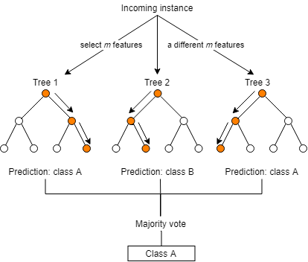
Random Forest (RF）
Random forests(RF) or random decision forests are an ensemble learning method for classification, regression and other tasks that operate by constructing a multitude of decision trees at training time and outputting the class that is the mode of the classes (classification) or average prediction (regression) of the individual trees. Random decision forests correct for decision trees' habit of overfitting to their training set, and their generally outperform decision trees.

Slide 18
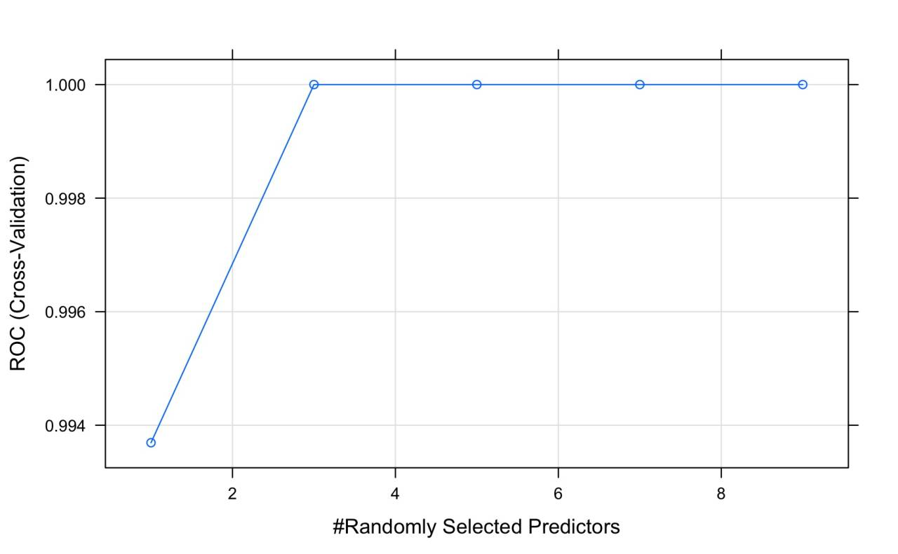
Random Forest (RF）
Parameter Selection:

Slide 19
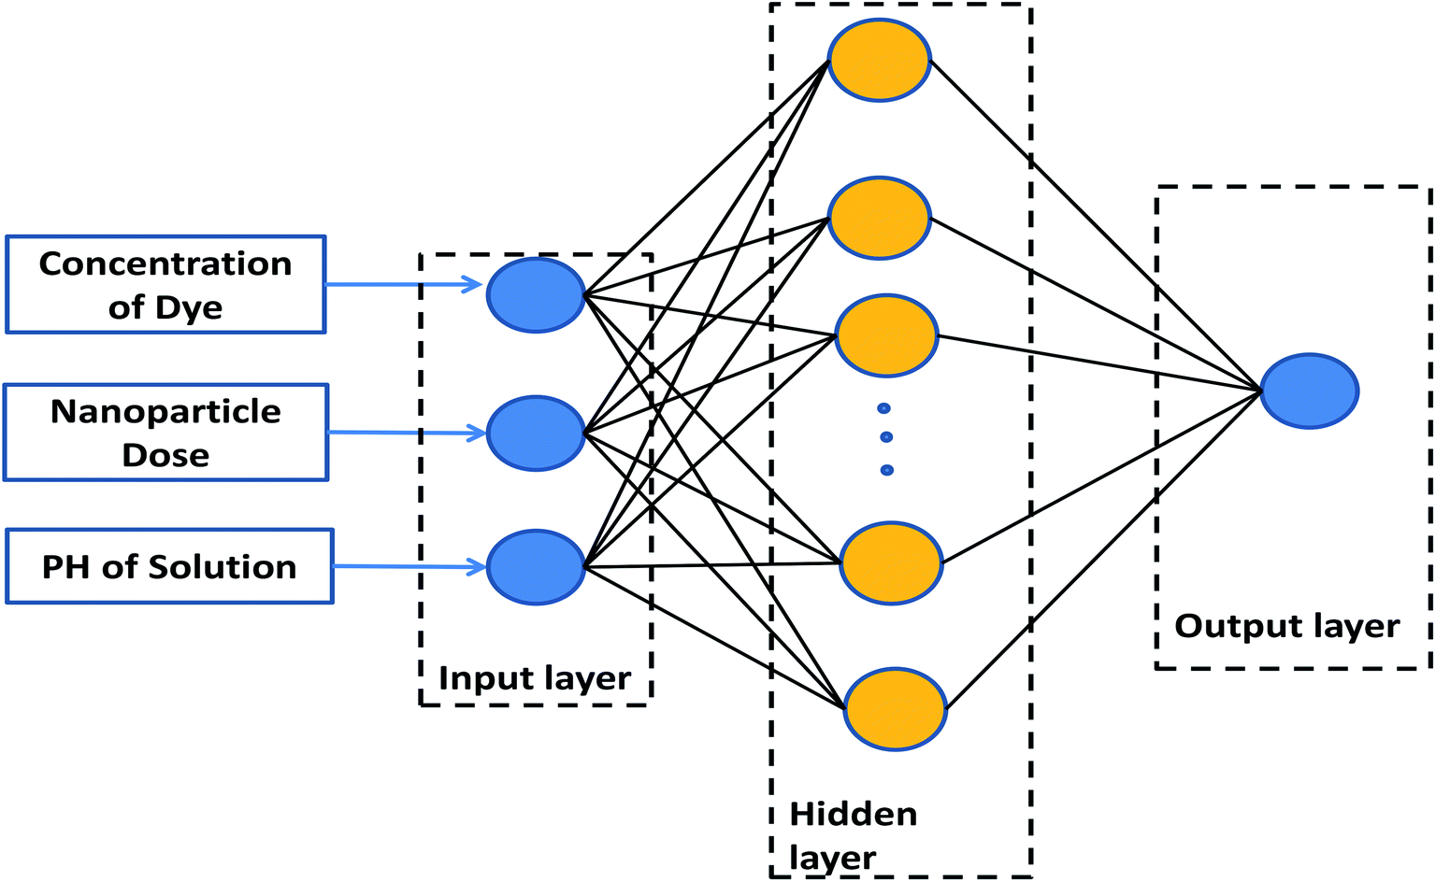
Artificial Neural Network (ANN）
An artificial neural network (ANN) is the piece of a computing system designed to simulate the way the human brain analyzes and processes information. It is the foundation of artificial intelligence (AI) and solves problems that would prove impossible or difficult by human or statistical standards.
Advantage:
1. Powerful tool to modeling complex non-linear functions.

Slide 20
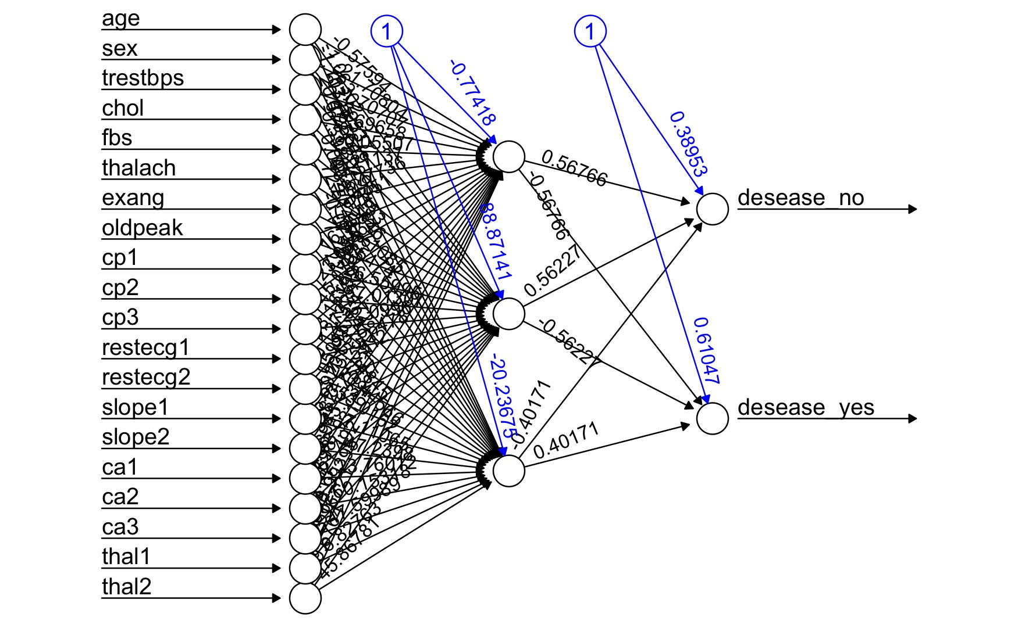
Artificial Neural Network (ANN）
ANN Plot

Slide 21

PART III
Model Selection

Slide 22
Model Comparison
 | Accuracy | Specificity | Sensitivity | ROC
GLM | 0.8276 | 0.7692 | 0.8750 | 0.9183
LDA | 0.8966 | 0.7727 | 0.8893 | 0.8963
KNN | 0.8621 | 0.7091 | 0.8911 | 0.8795
RF | 0.8966 | 0.7636 | 0.8126 | 0.8780
ANN | 0.7931 | 0.8571 | 0.7333 | NAN

Slide 23

PART IV
Key Findings

Slide 24
Review logistic regression
Coefficient | exp-tranform
Sex | 5.50
Trestbps | 1.03
Thalach | 0.96
Cp3 | 8.65
Ca1 | 6.58
Ca2 | 15.47
Ca3 | 7.67
Thal2 | 4.73

Slide 25

PART V
Fraud Detection

Slide 26
Explanation for significant variables
 | Factor | AUC
1 | Thal2 | 0.81
2 | Cp3 | 0.75
3 | Thalach | 0.70
4 | Sex | 0.67
5 | Ca2 | 0.66
6 | Trestbps | 0.66
7 | Ca3 | 0.54
8 | Ca1 | 0.52

Slide 27

Explanation for significant variables
 | Factor | AUC
1 | Thal2 | 0.81
2 | Cp3 | 0.75
3 | Thalach | 0.70
4 | Sex | 0.67
5 | Ca2 | 0.66
6 | Trestbps | 0.66
7 | Ca3 | 0.54
8 | Ca1 | 0.52
Asymptotically chest pain (Cp3), also called silent pain.
According to medical research, about 45 percent of heart attacks may be silent. Enough sleep is the most effective way to prevent.

Slide 28
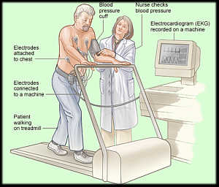
Explanation for significant variables
Thallium test is injected during peak exercise and will be extracted by the hearts muscle tissue.
 | Factor | AUC
1 | Thal2 | 0.81
2 | Cp3 | 0.75
3 | Thalach | 0.70
4 | Sex | 0.67
5 | Ca2 | 0.66
6 | Trestbps | 0.66
7 | Ca3 | 0.54
8 | Ca1 | 0.52
According to medical research, “0” means ideal situation. “2” means it needs some time to recover normal distribution.

Slide 29

PART VI
Summary

Slide 30
Procedure review
Logistic Regression and 4 machine learning models: LDA, KNN, random forest tree, ANN.
Best model on prediction: LDA
Best model on explanation: Logistic Regression

Slide 31
Conclusions
Major factors cause heart disease:
Sex and asymptotically chest pain.
Major symptoms of heart disease:
Insufficient blood supply.
So who break your heart?
Age !

Slide 32
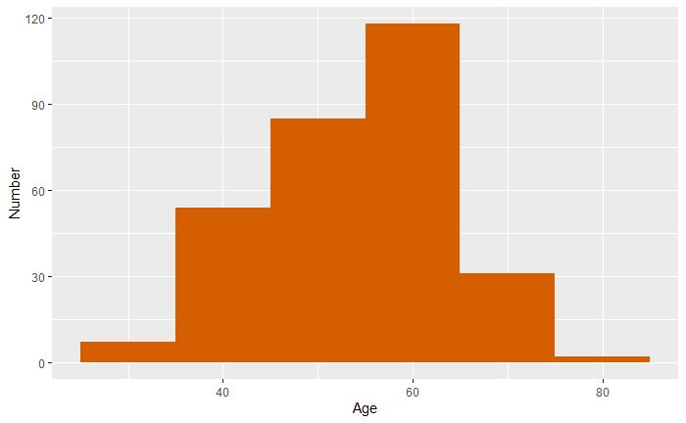
Limitations of data and model
Old people are dominant.

Slide 33
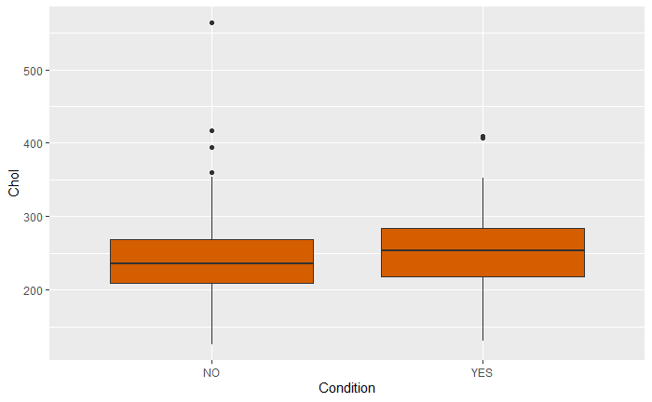
Limitations of data and model
High cholesterol people are dominant.

Slide 34
Further study
Collect stratified sample in a more general group.
Find more latent risky factors and control condition to explore the relation with the heart disease (casual inference).

Slide 35
THANK YOU

